Slide 1
A new hope
Team Indigo
P&O Computerwetenschappen
Wander Bavin
Vince Goossens
Dimitri Jonckers
Sunil Tandan
Wout Vekemans

Slide 2
contents
Assignment
Physical design
Software
Algorithms
Demo
Collaboration
Conclusions

Slide 3
Assignment
Autonomous zeppelin
Grid manoeuvring
Zeppelin race
(foto grid)

Slide 4
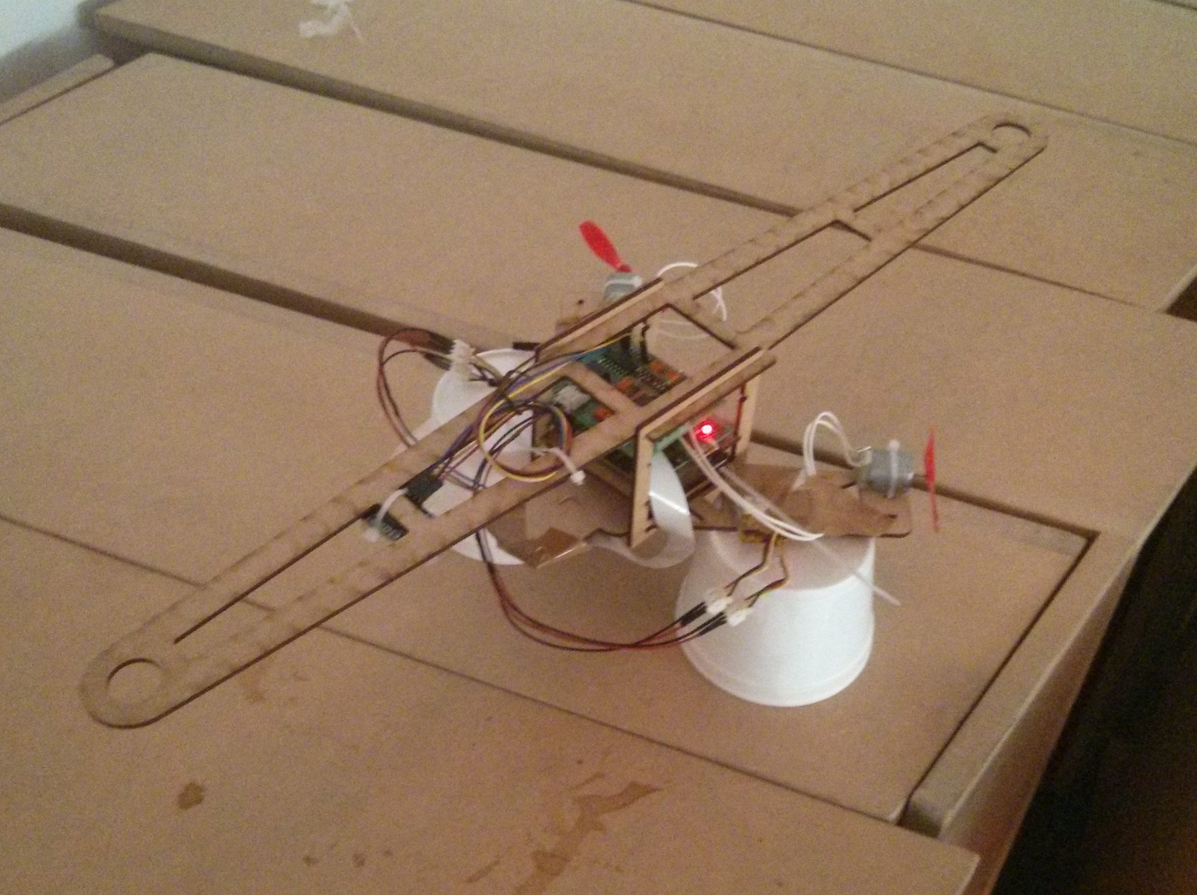
Physical Design

Slide 5
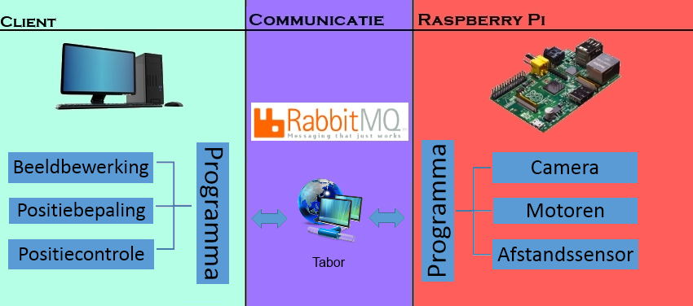
Software
Java
Open CV
Notes:
Java
Iedereen was gewend. Nodige libraries van java gevonden. Het leek efficiënter om Java te gebruiken.
Click
Client – Server model met drie belangrijke delen.

Slide 6
Communication
Ad-hoc
image feed (pi → laptop)
Rabbit MQ
status, commands…
ANIMATION

Slide 7
Algorithms
PID
Height
Horizontal: x,y
Image recognition
Positioning
Image recognition video

Slide 8
Pid
Height
Same parameters previous semester
Horizontal
Independent x and y
Simple navigation (no rotation)

Slide 9
Image REcognition
Colour accurate, shapes mostly
Correction previous recognitions
Colour Symbol at incomplete triangle
Multiple triangles → unknowns
→ distance to center
(foto)

Slide 10
Positioning
Location
Unique triangle
Multiple possibilities (unknowns)
Correction previous location
Orientation
Horizontal symbols on map (// grid edge)

Slide 11
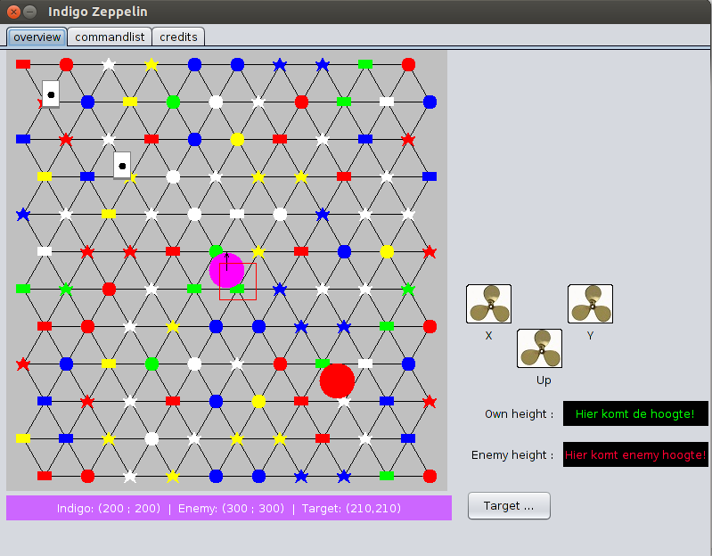
Simulator

Slide 12
Demo: accomplishments
Height PID
Connection could be established
Simulator
Both simulators worked
Target movement
Qr-code
Image recognition

Slide 13
demo: disappointments
Positioning error
grid size
QR-code error
tablet trouble

Slide 14
Image recognition video

Slide 15

collaboration
Experiences
Great atmosphere
Knowledge apprehended
Difficulties
Dividing workload

Slide 16

Conclusion
Strengths
Robust image recognition
Advanced positioning
Design zeppelin (no rotation)
Difficulties
Only five people
Trouble at demonstration
Java/Open Cv

